Slide 1
Modern Programming Practices

Slide 2
Who wants to improve his or her English?

Slide 3
English Learning Online System
Guided by proffesor Shafqat
Hui Xiubao
Jamsrandorj B.

Slide 4
Description
There are two sides, student side and professor side
Student: select the courses, download study materials, and give feedback for the course
Professor: create courses, upload the materials for the course and reply the feedback from the students

Slide 5
Technologies
Server Side: JAVA EE
Client Side: JavaServer Pages-JSP
Database: MYSQL
Tools: Eclipse, Tomcat-Server, Github-Source Control, Workbench-DB Management

Slide 6
Project Plan
Feature | Begin | Duration(day) | End
diagrams | 22-Jan | 1 | 22-Jan
env:git | 22-Jan |  | 22-Jan
env:mysql | 22-Jan |  | 22-Jan
env:jsp | 22-Jan |  | 22-Jan
env:servlet | 22-Jan |  | 22-Jan
design:UI | 23-Jan | 1 | 23-Jan
design:mysql | 23-Jan |  | 23-Jan
design:interfaces | 23-Jan |  | 23-Jan
coding | 24-Jan | 1 | 24-Jan
United tune | 26-Jan | 1.5 | 27-Jan
Improve the material | 28-Jan | 1 | 28-Jan

Slide 7
Architecture Diagram

Slide 8
Association Matrix
 | Student | Professor | Course | Material | Feedback
Student |  | Teach | Enroll | Downloaded | Given by
Professor | Taught by |  | Create | Uploaded | Replied by
Course | Enrolled by | Created by |  | Referenced | Referenced
Material | Download | Uploaded by | Referenced
Feedback | Given by | Replied by | Referenced

Slide 9
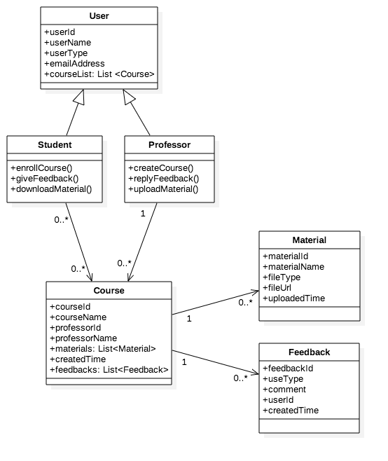
Class Diagram

Slide 10
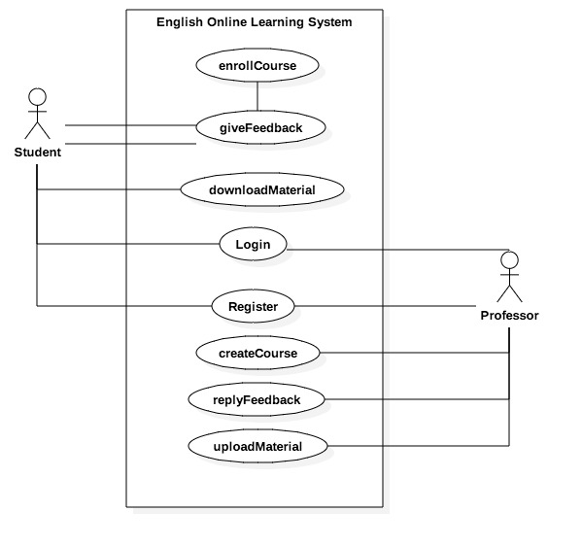
Use Case Diagram

Slide 11
Use Case Diagram
WITHDRAW_MONEY Use Case Description: Student
User Action | System Response
register | create the user infor
2. login | 2. access into the
3. enroll course | 3. add the course to the student
4. download the material | 4. return the material file

Slide 12
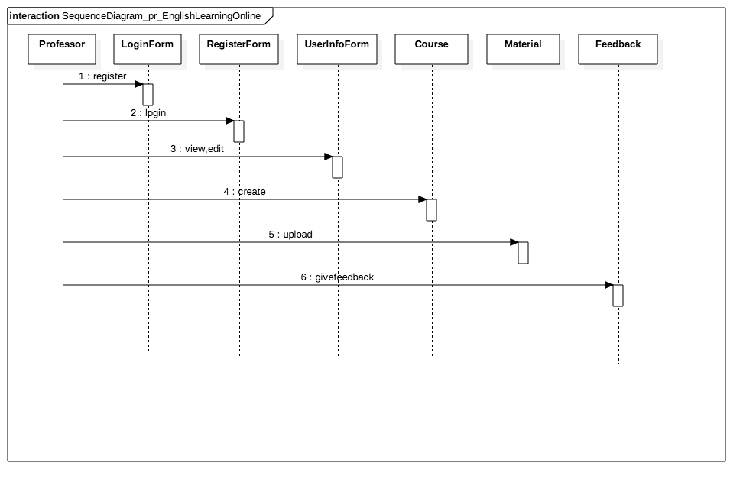
Sequence Diagram

Slide 13
Sequence Diagram

Slide 14
Experience Share
Libs:
commons-fileupload use,it should be also put into the tomact installation path
Database:
create database:B_URL_INIT = "jdbc:mysql://localhost:3306”
getConnection:jdbc:mysql://localhost:3306/db_englishlearningonline
Others:
Clear architecture
Code management
Welcome to discuss technical issues any time!

Slide 15
Thank You
Hui Xiubao
Jamsrandorj B.

